Slide 1

Exploratory Data Analysis on Plant Data
Key statistics
Elemental and spectral readings in IR
Low Variance in the measurements
Balanced Dataset
Most measurements follow a Normal Distribution
Analyzed Elemental Data first and then shifted to Spectral Data
Applied PCA to reduce the dimentionality
A look into how light and various elements affect the health of a plant
-Pragyan Jyoti Dutta

Slide 2
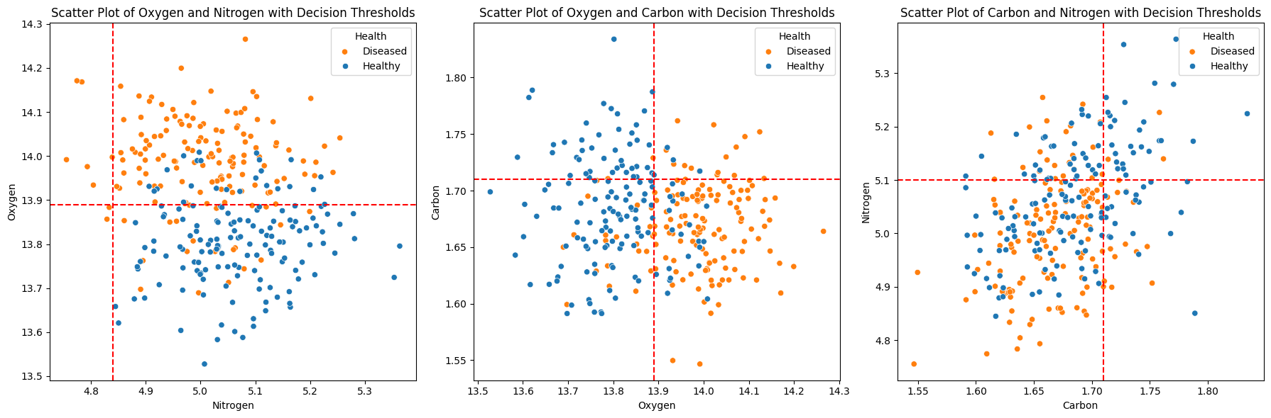

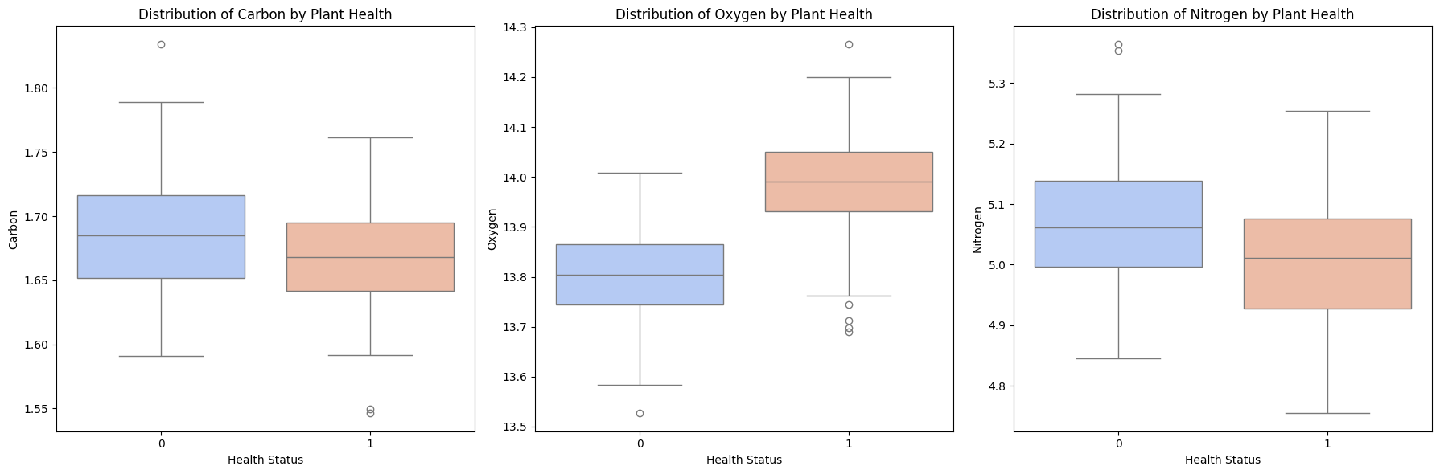
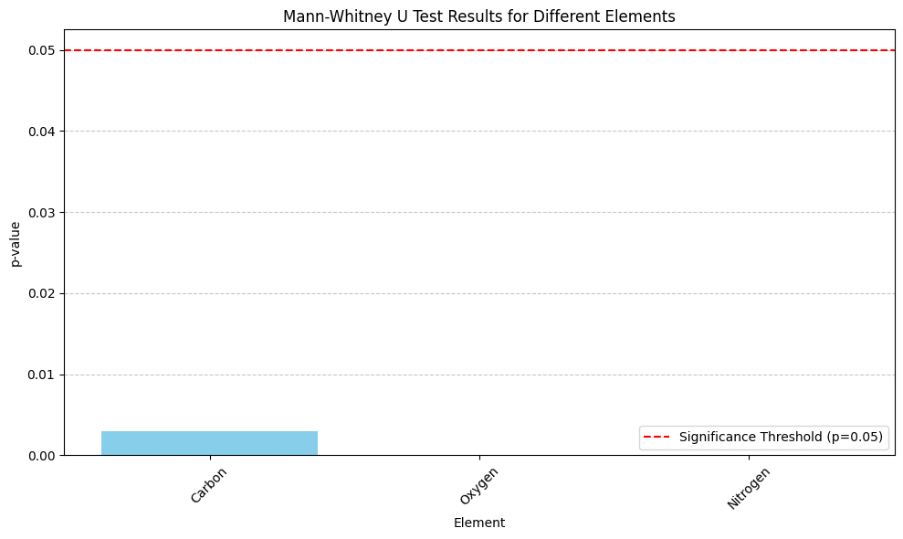
Initial Findings
Elemental and spectral readings in IR
Low Variance in the measurements
Balanced Dataset
Most measurements follow a Normal Distribution while a few are skewed.
Analyzed Elemental Data first and then shifted to Spectral Data
Applied PCA to reduce the dimentionality
- Boxplot to get basic information about the distribution of plants.
- Mann-Whitney U test to compare the distribution of the 3 elements between Healthy and Diseased
- Scatter plot to determine a Decision Boundary for Healthy and Diseased plants

Slide 3


Elemental Analysis
- Boxplot to get basic information about the distribution of plants.
- Mann-Whitney U test to compare the distribution of the 3 elements between Healthy and Diseased
- Scatter plot to determine a Decision Boundary for Healthy and Diseased plants
Carbon levels tend to be slightly higher for diseased plants.
Oxygen levels are generally high for healthy plants
Slightly Higher IQR for diseased plants
Interesting case of outlier in healthy plant with levels similar to that of diseased plants
Diseased plants have a little higher Nitrogen compared to healthy plants and a much broader range

Slide 4
Oxygen levels are generally high for healthy plants
Slightly Higher IQR for diseased plants
Interesting case of outlier in healthy plant with levels similar to that of diseased plants
Carbon levels tend to be slightly higher for diseased plants.
Diseased plants have a little higher Nitrogen compared to healthy plants and a much broader range
Mann-Whitney U test:
It would help to determine if there is a statistically significant difference in the elemental composition between the two groups of plants.
Results:
Carbon - Mann-Whitney U test p-value: 0.0029871645347513817
Oxygen - Mann-Whitney U test p-value: 7.370825967074484e-33
Nitrogen - Mann-Whitney U test p-value: 2.7295211243743914e-06
No statistically significant difference in the levels of the elements between the healthy and diseased plant groups.
Thus it might not be a reliable factor for determining plant health with respect to the specific disease under consideration.

Slide 5
Elemental Analysis
Mann-Whitney U test:
It would help to determine if there is a statistically significant difference in the elemental composition between the two groups of plants.
Results:
Carbon - Mann-Whitney U test p-value: 0.0029871645347513817
Oxygen - Mann-Whitney U test p-value: 7.370825967074484e-33
Nitrogen - Mann-Whitney U test p-value: 2.7295211243743914e-06
No statistically significant difference in the levels of the elements between the healthy and diseased plant groups.
Thus it might not be a reliable factor for determining plant health with respect to the specific disease under consideration.
Notes:
Used to compare the distributions of the elements between healthy and diseased plants.

Slide 6
Elemental Analysis
Determining a Decision Boundary:
Used a DecisionTreeClassifier to learn from the data to give us a threshold value to differentiate healthy and diseased plants.

Slide 7
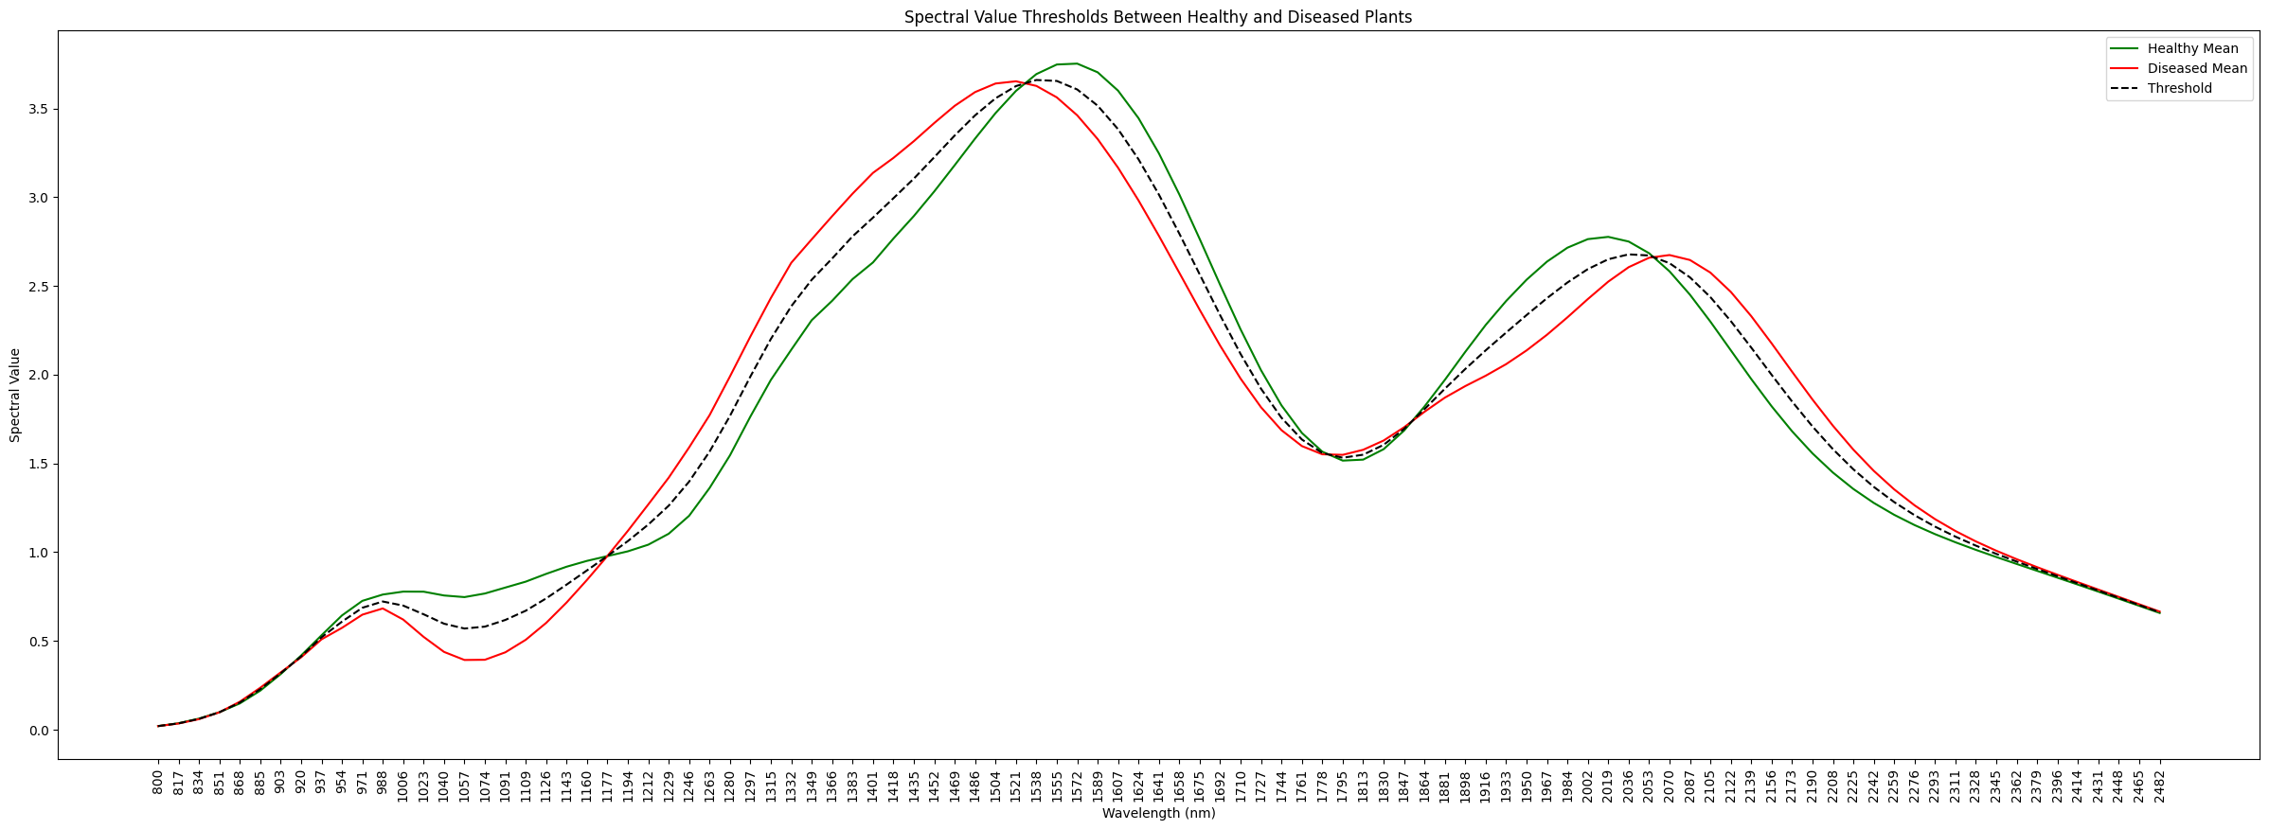
Lower Right Quadrant has predominantly Healthy plants.
While Upper Left Quadrant has predominantly diseased plants.
Not immune to outliers.
Lower Right Quadrant has predominantly Diseased plants
While Upper Left Quadrant has predominantly Healthy plants.
Not immune to outliers.
Scatter plot between Carbon and Nitrogen couldn’t find a suitable threshold for efficient differentiation

Slide 8

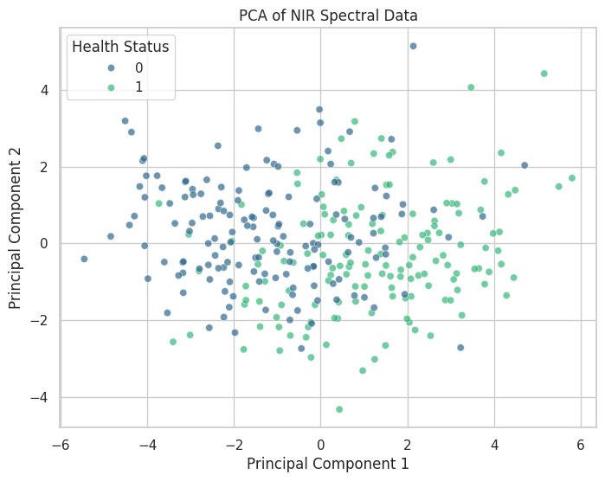
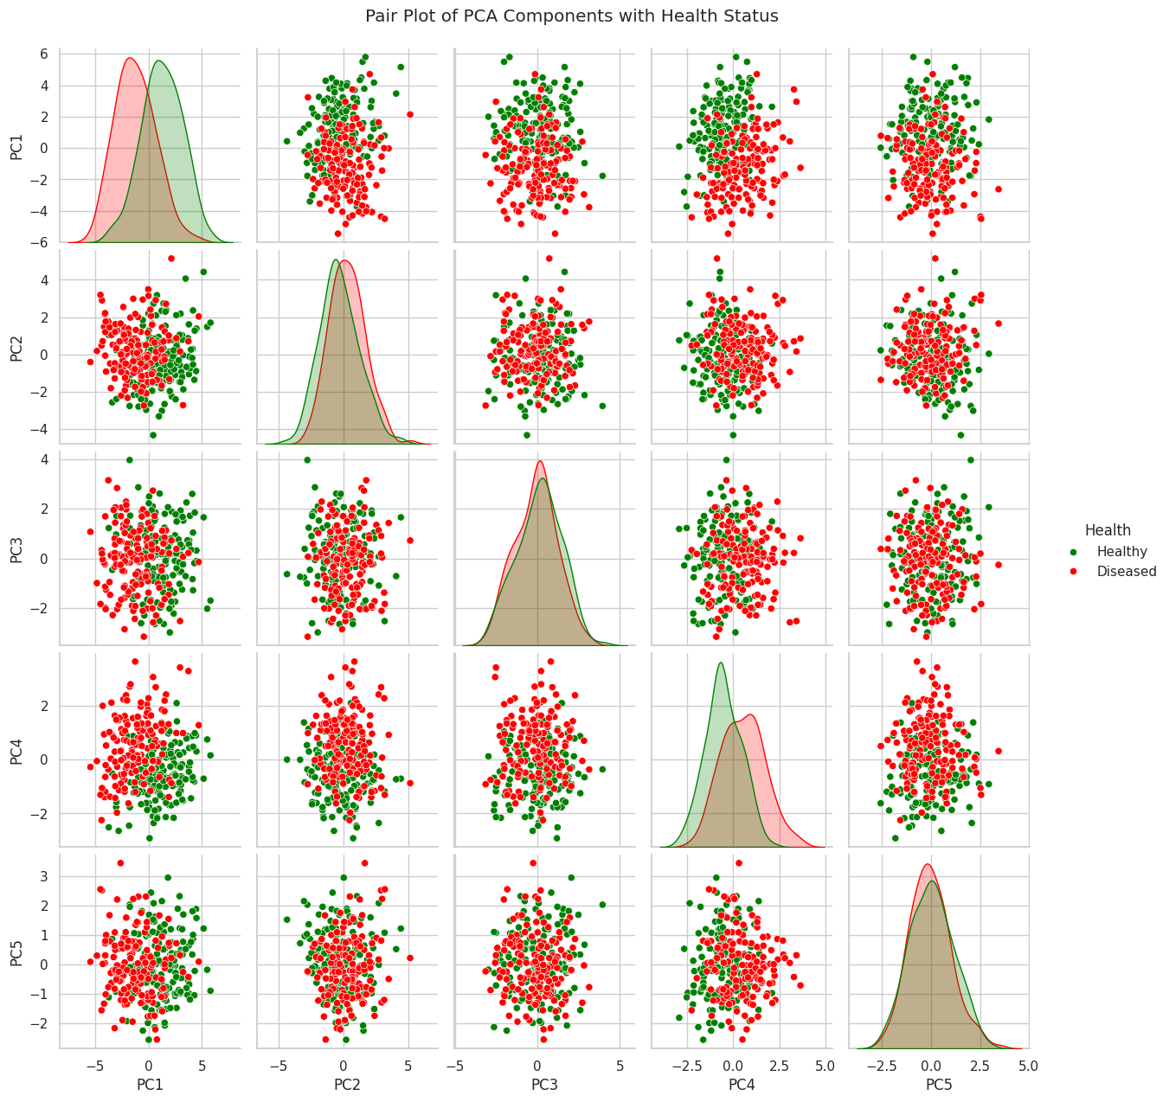
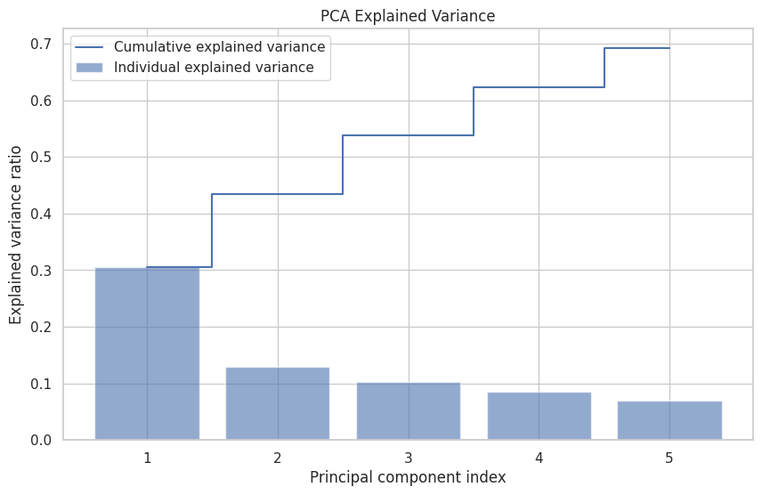
Spectral Analysis
Healthy above threshold:
937nm - 1177nm
1538nm - 1178nm
1864nm - 2036nm
Healthy below threshold:
1177nm – 1538nm
2070nm - 2396nm
Notes:
For each group, the mean spectral value is calculated for each wavelength
the threshold is calculated as the average of the mean spectral values of the healthy group and the diseased group.
- used mean because it represents the average response across the spectrum for each group.

Slide 9
Applying PCA
Notes:
-Reduced the dimentionality to 2 using PCA.
-

Slide 10
Applying PCA
Notes:
- with 2 about 45% variance was caught.
- with 5 components was able to capture about 70% variance in the data.

Slide 11
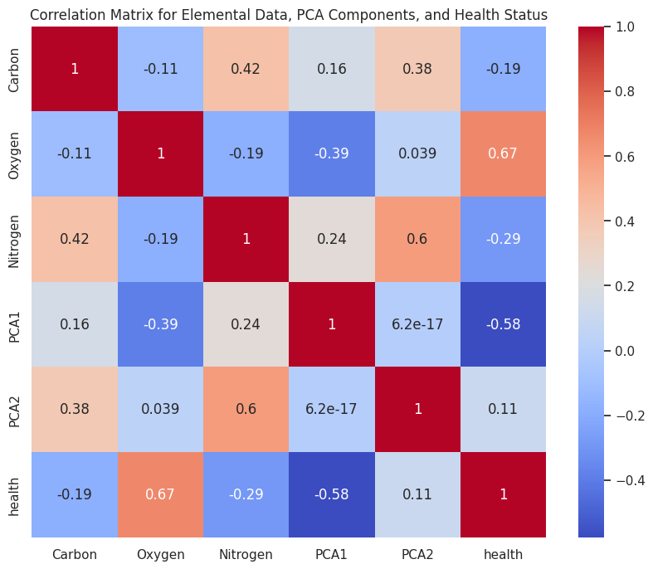
Final points
Applying PCA
Low correlation between the wavelength components and health indicating wavelength alone doesn’t determine the health of a plant.
Oxygen and health have a significant correlation indicating healthy plants generally have higher Oxygen content.
There’s also considerable correlation between Nitrogen and the second PCA (0.6) component meaning the Nitrogen content increases with increasing wavelength as well as the Carbon (0.42) content. It shows there exists subtle multicollinearity between PC2, Nitrogen and Carbon.
Notes:
- Overlapping distributions suggest that the PCA component may not clearly distinguish between healthy and diseased plants.
-The scatter plots reveal that there is no clear linear boundary separating healthy from diseased plants, which indicates that the relationship between these components and the health status is not simply linear or may require more complex modeling to unravel.

Slide 12
Final points
Low correlation between the wavelength components and health indicating wavelength alone doesn’t determine the health of a plant.
Oxygen and health have a significant correlation indicating healthy plants generally have higher Oxygen content.
There’s also considerable correlation between Nitrogen and the second PCA (0.6) component meaning the Nitrogen content increases with increasing wavelength as well as the Carbon (0.42) content. It shows there exists subtle multicollinearity between PC2, Nitrogen and Carbon.

Slide 13
References:
Ge, Y., Atefi, A., Zhang, H. et al. High-throughput analysis of leaf physiological and chemical traits with VIS–NIR–SWIR spectroscopy: a case study with a maize diversity panel. Plant Methods 15, 66 (2019). https://doi.org/10.1186/s13007-019-0450-8
For more information about the EDA process refer the following notebook: https://colab.research.google.com/drive/1pMW6LgbsEqI4jedXJ_HyU9YOw-N07ZT5?usp=sharing

Slide 14
THANK YOU

